Slide 1

Numerology ISM Presentation
Contextualizing Numerology's Pertinence to Personal Identity Construction in Singapore
By Ibrahim Sharul

Slide 2
Contents of Presentation
Topic and its significance
Definition of terms
Framework
Summary of findings
Recommendations and projections
Central Question of Inquiry & main argument

Slide 3
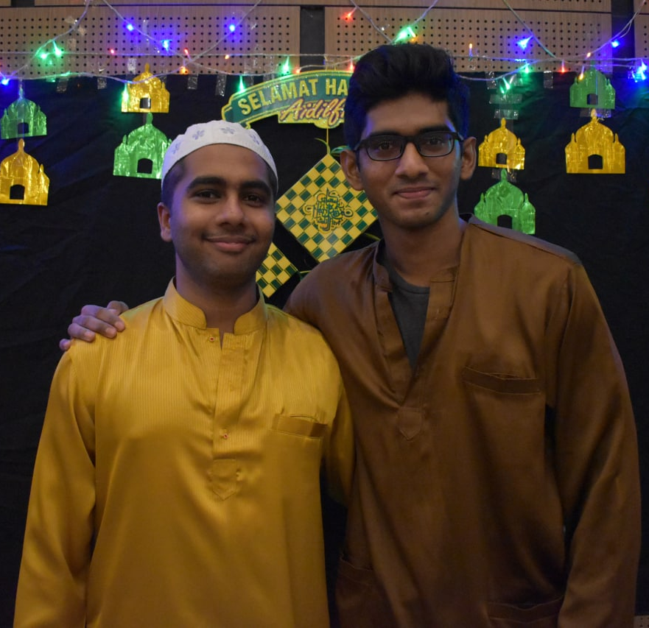
Topic: Pythagorean Numerology
A pseudoscience that is quite accurate and useful but is not widely adopted or accessible in Singapore
Awareness is low among those interviewed
Scope for usefulness for people to better understand themselves
Helped me and my girlfriend make sense of who we are and the struggles we face
Inspired by friend to research on this
My Friend Dhameem who inspired me to do this ISM

Slide 4
My story
Went for numerology course externally because of my love for numbers
Came across it in Bugis next to the mosque
The description was very accurate
Tested it on others with high accuracy
Wanted to know how useful others would find it

Slide 5

Inquiry Question and key argument
Question:
How useful people might find Numerology to understand who they are and the life events that shape them which could aid in forming their personal identity
My Argument:
I will make the case that since Pythagorean Numerology can be a useful tool to construct one’s personal identity by providing insights into their inborn characteristics such as our masculinity, risk-taking propensity, tendency to feel spirits, natural talents and the values and characteristics we find important, and to contextualise the life events that shape them such as the struggles faced and lessons meant to be learnt, its visibility and adoption should be accentuated in Singapore.

Slide 6
Definition of key terms
Term | Definition
Personal Identity | Our self-image What defines us (the characteristics) Socially constructed from social interactions Changes over time due to new experiences
Pythagorean Numerology | Study of numbers which provides insights to ourselves of who we are, our talents and our struggles and lessons to learn in this lifetime By Pythagoras in 5th Century, using English full name and Date of Birth (DOB) Uses single digits 1-9
Inborn characteristics | Masculinity risk-taking propensity tendency to feel spirits Natural talents Values and Characteristics we find important
Life Events | The struggles we might face Situations we might find ourselves in

Slide 7
Research Methodology
Primary research
- Friends in university
- Residents of Cinnamon College, students in NUSC
Using a python script, generate a report
Adopt a facilitative approach to do a reading
Type of Survey
Quantitative (Rank 1-10 for each of the insights derived)
Qualitative (Elaborate more of how far do you agree/disagree)

Slide 8
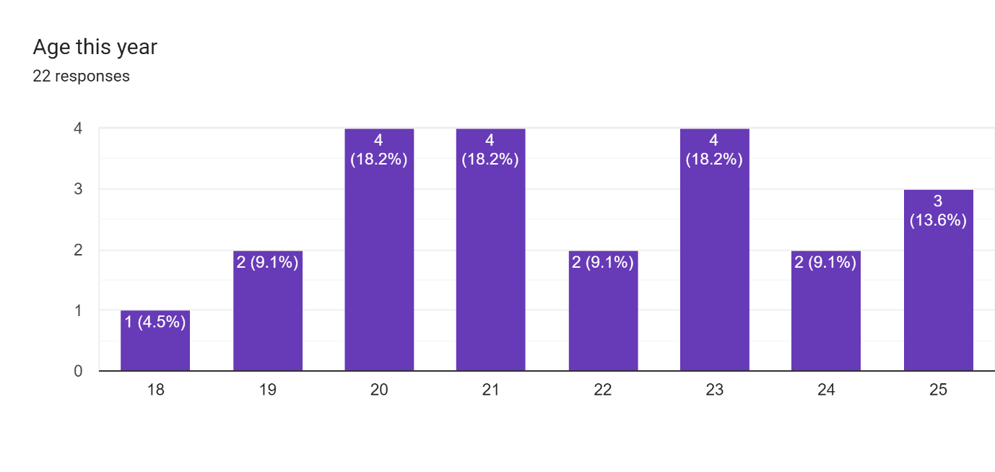
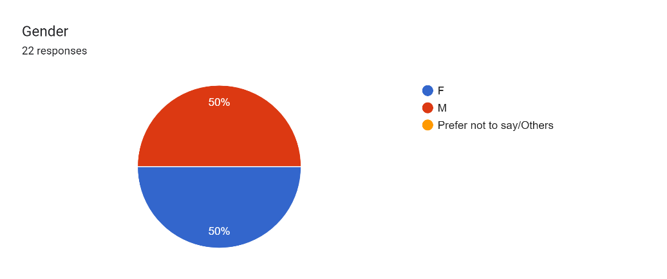
Interviewed 22 students aged 18-25

Slide 9
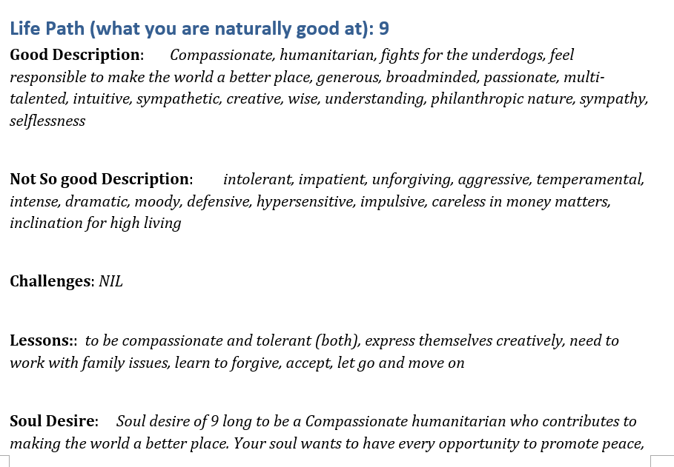
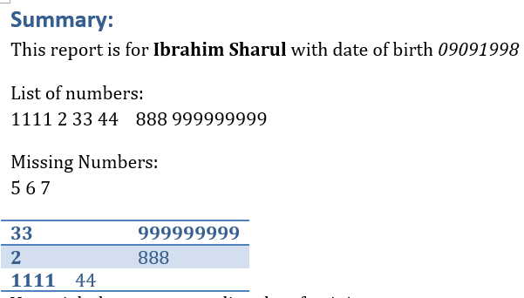
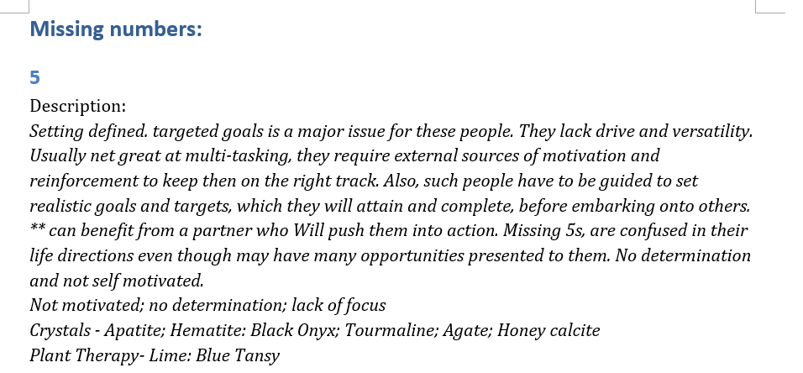
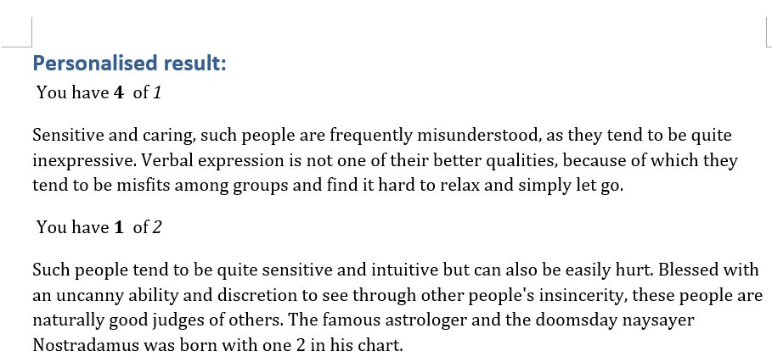
Sample Report

Slide 10
Pertinent Numbers in Numerology
Number | Description | How it is derived
Life Path | Our natural talents | From sum of digits in DOB
Destiny Number | What we are meant to learn in this life time | Adding digits in full name
Personality number | Who we are as a person | Day of birth
Inner Personality Number | Our inner soul desire Our real self we show to our close ones | Sum of vowels in full name
Want to be Perceived Number | How we wish people perceived us | Sum of consonants in name
Missing Numbers | The domains we might find ourselves struggle a lot | Seeing if any number is missing from our chart
Individual Result | Descriptions of who we are | The quantity of each number in the chart

Slide 11
Numerology is useful in constructing our personal identity
Personal Identity
The inborn characteristics that define us
Masculinity
risk-taking propensity
tendency to feel spirits
Natural talents
Values and Characteristics we find important
The events that occur in their life
Struggles we face
The situations we find ourselves in/gravitate towards due to the lessons we need to learn

Slide 12

Demo

Slide 13
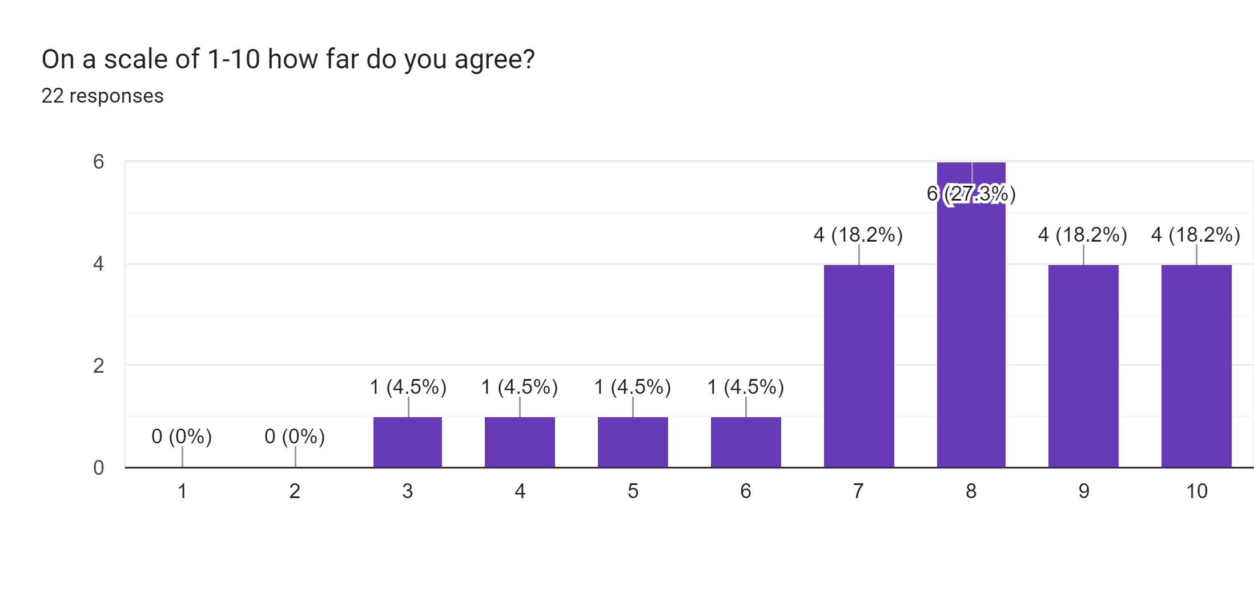
Statistics (Life Path)

Slide 14
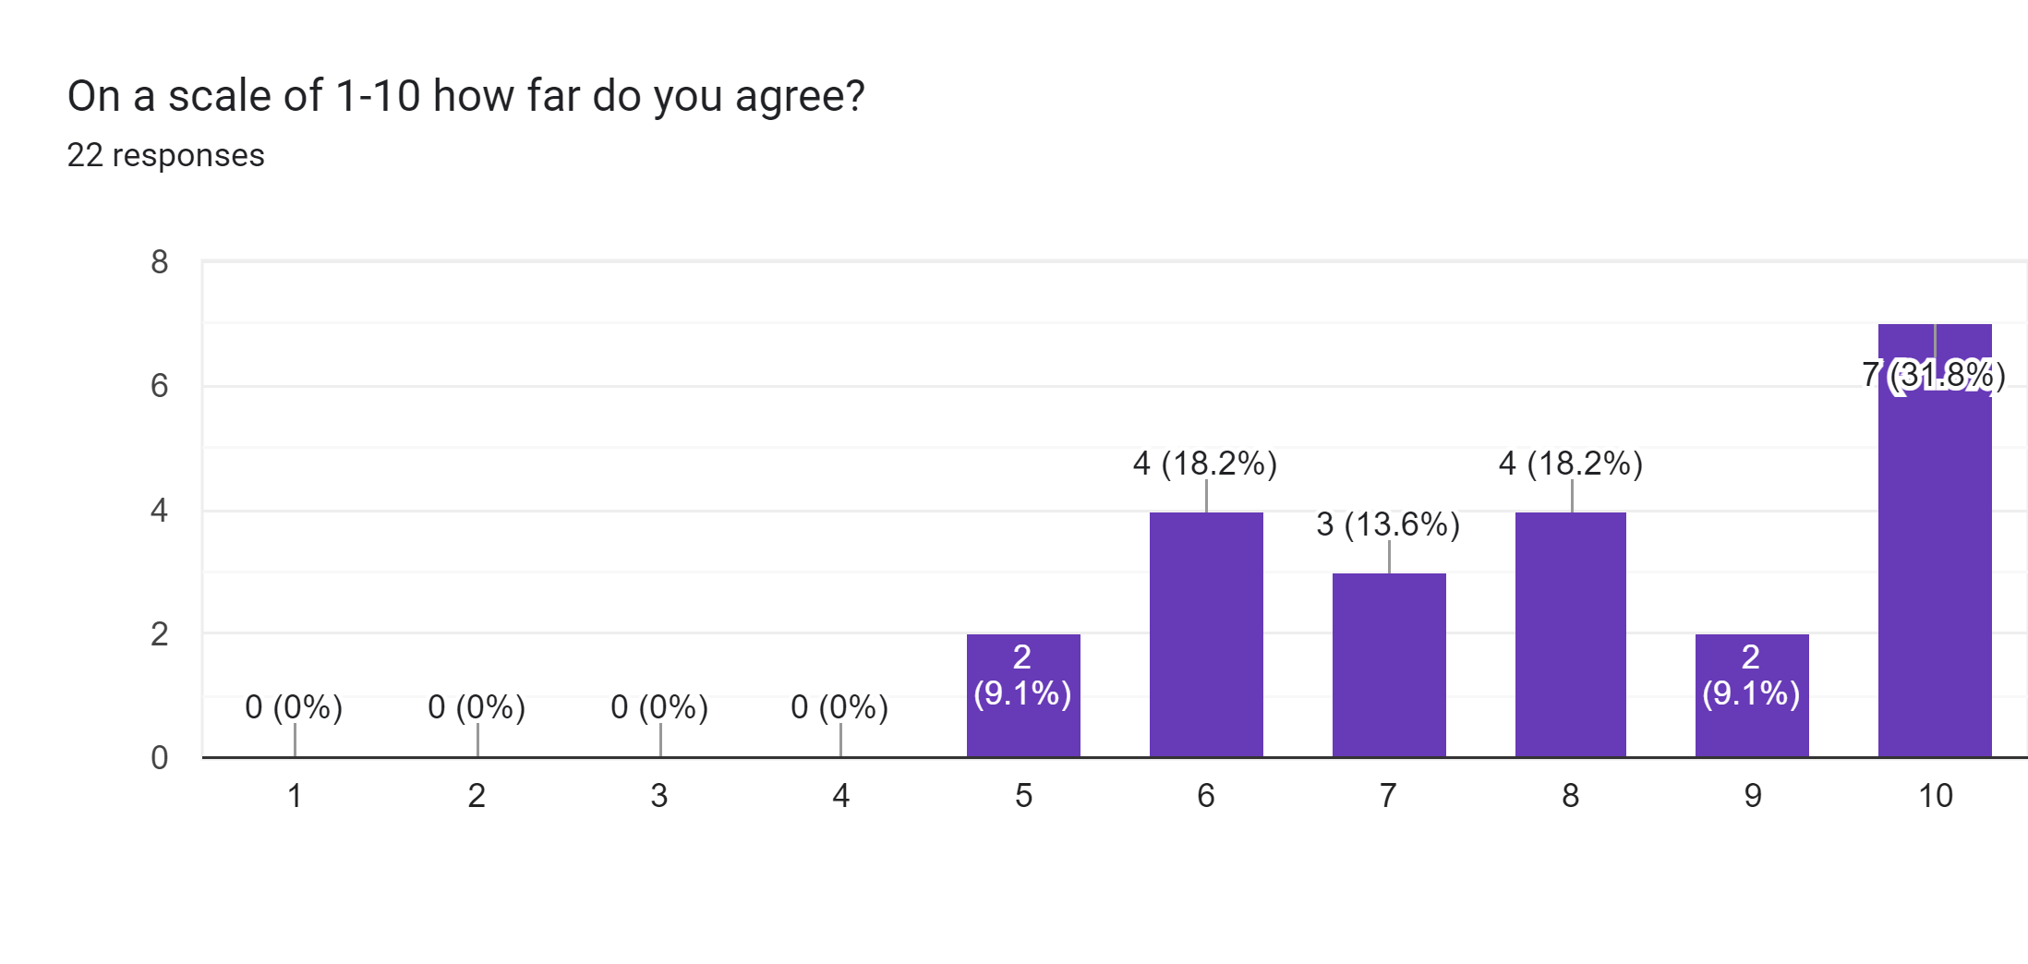
Statistics (Destiny Number)

Slide 15
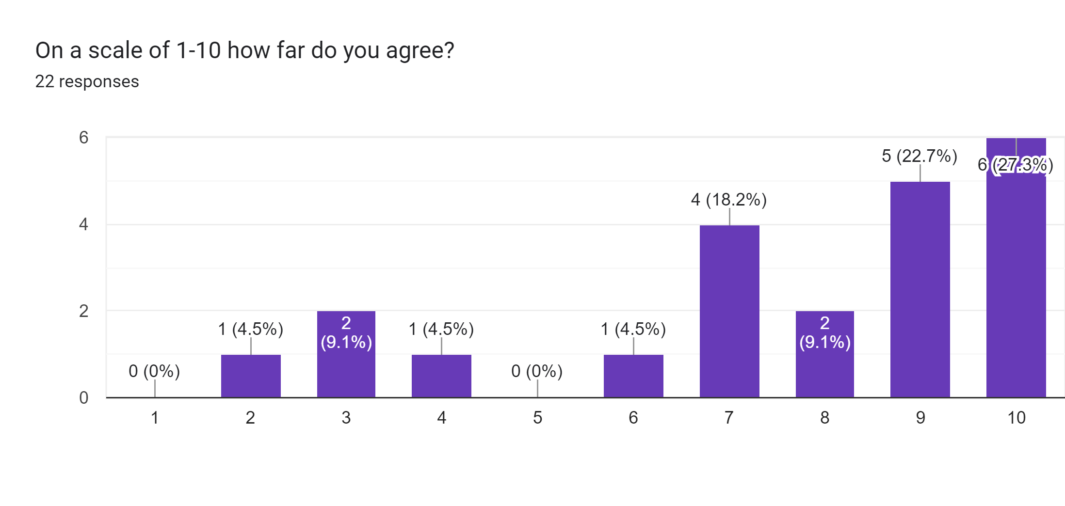
Statistics (Inner Soul Desire)

Slide 16
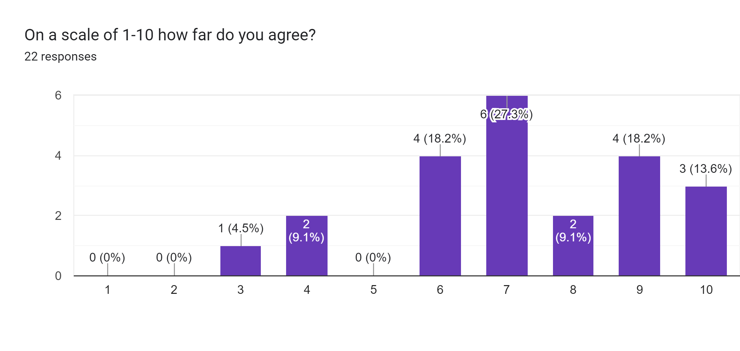
Statistics (Want to be perceived as)

Slide 17
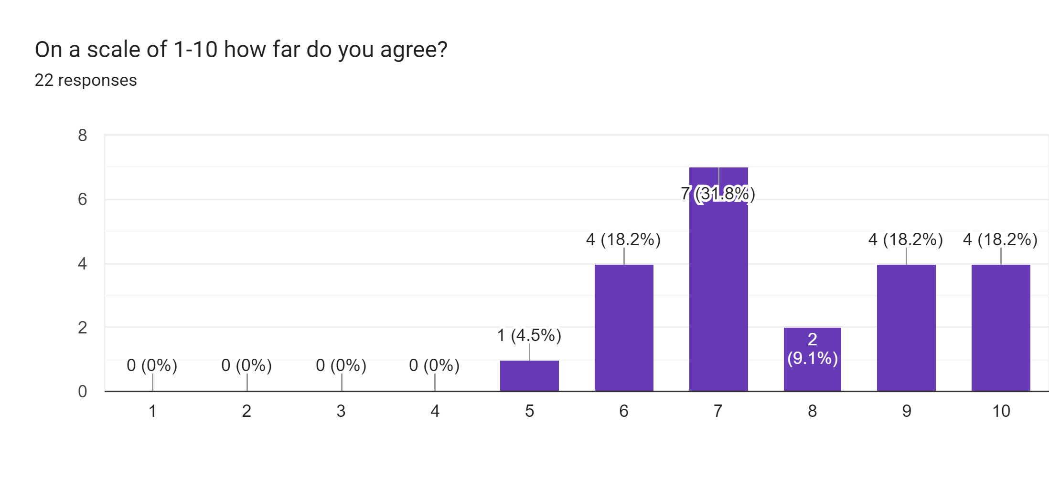
Statistics (Missing Numbers)

Slide 18

Some observations
Indians and Malays have more 9s
Indians tend to be more masculine
International students tend to agree less (perhaps due to age) or could be lack of self-awareness
Numerology gave reassurance for those struggling more than those balanced

Slide 19
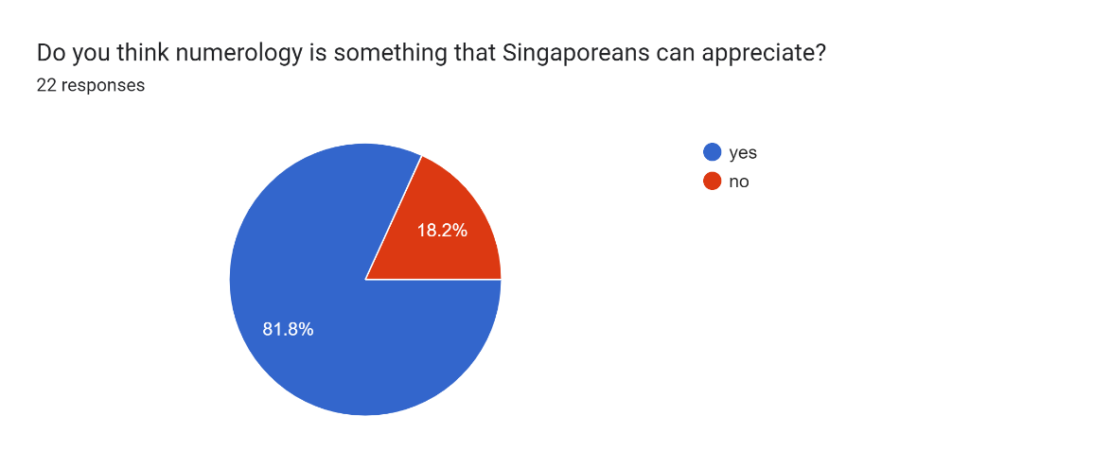
Is Numerology something Singaporeans can appreciate?

Slide 20
Some issues faced
Lack of awareness
Scepticism (eerie girls)
Conflict with religious belief
Accessibility

Slide 21
What can be done to increase adoption?
Create awareness using social media as a potential personality test equivalent
Doing quantitative survey to show its accuracy
Reduce price of getting reading or learning about Numerology
Allowing of Skill Future credits for learning about Numerology

Slide 22

Limitation of study/Future research avenues
Recent experience might mean not being able to extract all relevant insights
Absence of master numbers to analyse
Only limited to youth, could explore the utility among other age groups
Idea of Missing Numbers 3 and 6 to aid governmental efforts to aid individuals with depression and from broken families

Slide 23

Future trajectory
Numerology will gain more traction in Singapore and overseas once
Awareness of its benefits increases
Marketed properly as a personality test/tool to better understand ourselves
Accessibility increases through price reduction
People understand that numerology is a religion-neutral tool

Slide 24
Lessons learnt
Doing a proper social science paper of 5k length
Formulating my own framework to analyse an issue
How to give numerology readings effectively while getting to know others
Doing what I like but incorporating the academic elements of it

Slide 25
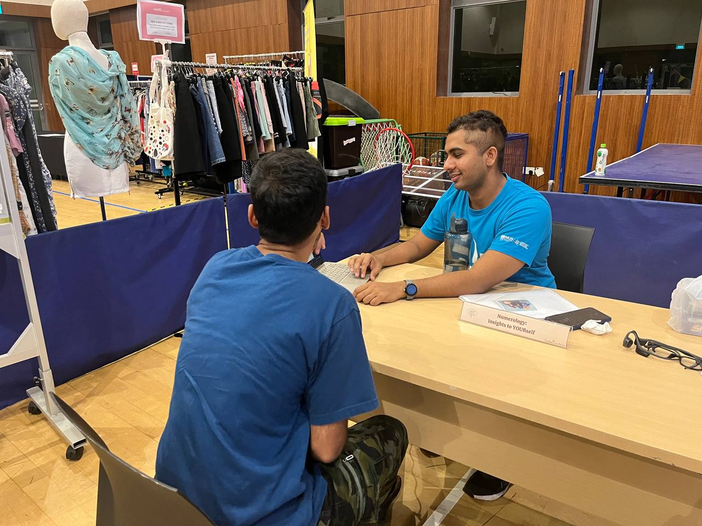
Q&A

